Slide 1

Blockchain at Michigan
Session 5: Tokens, DApp Governance, and the Government
Tuesday, March 15th, 2022

Slide 2
Sanity Check:
Final Group Project

Slide 3
Final Project
In order to “graduate” and qualify for consulting and other opportunities, all of you will prepare a group project by the end of the cohort
Deadline: April 12 - Presentation Day
On April 12th each team will have the opportunity to show off their work during the last cohort meeting
As of today you are free to form and register teams and begin working
All teams must be registered by Sunday, March 27th

Slide 4
Registering Teams
We will share a spreadsheet for team registration
Once you have a finalized team and project idea, make an entry to the spreadsheet by filling out every required question (column) for your team (row)
A team should typically consist of 3-4 people
All teams must be formed by Sunday, March 27

Slide 5
Tokens

Slide 6
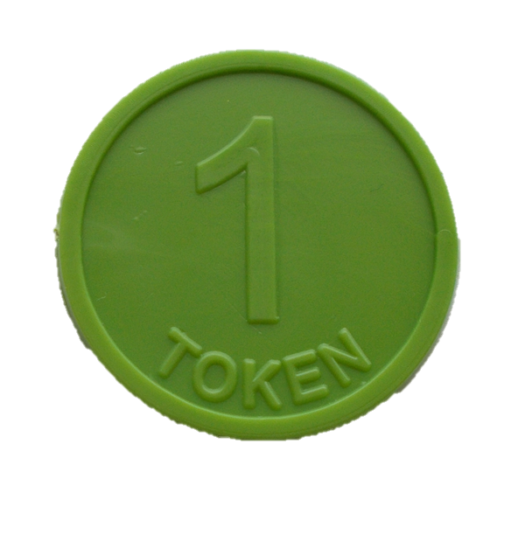
What is a Token?
Definition: A token is a digital asset issued on other cryptocurrencies’ ledger
Potential Uses:
Share representation of a company, protocol (i.e. process), or resource pool
Method of payment or trade in a particular ecosystem
Network Participation and Access
Proof of Ownership

Slide 7
Crypto coins vs. Tokens
Coins:
Each coin is deployed in its own environment (its own ledger)
Coins represent pure value (like any non-digital currency)
Tokens:
A token is deployed on the ledger of an existing cryptocurrency through smart contracts
Hold some form of value behind them (crypto, company stake, physical asset, or even the ability to do something)

Slide 8
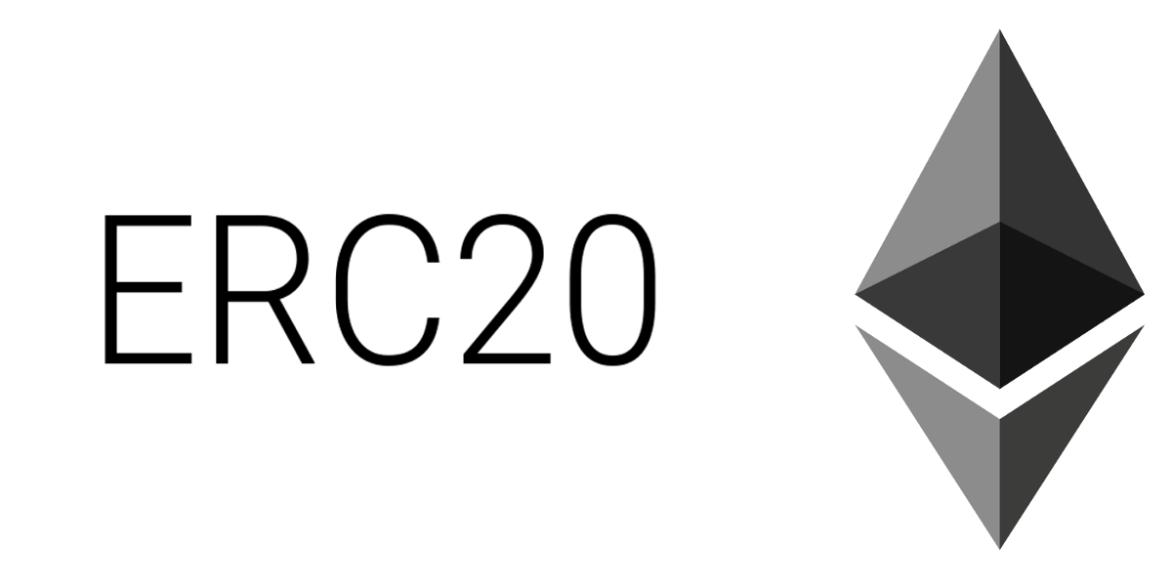
ERC-20
ERC-20 is one of the most significant and popular tokens on the Ethereum network
Learn More
Or Even More!

Slide 9
Types of Tokens
Utility Tokens: only valuable on the native network due to its network specific role in aiding the business or the transaction process (Example: 0x)
Commodity Tokens: General purpose tokens backed by standard assets with preexisting independent value (Oil, Gold, etc.)
Security Tokens: Assets that yield passive revenue and equate to stake in particular company or process

Slide 10
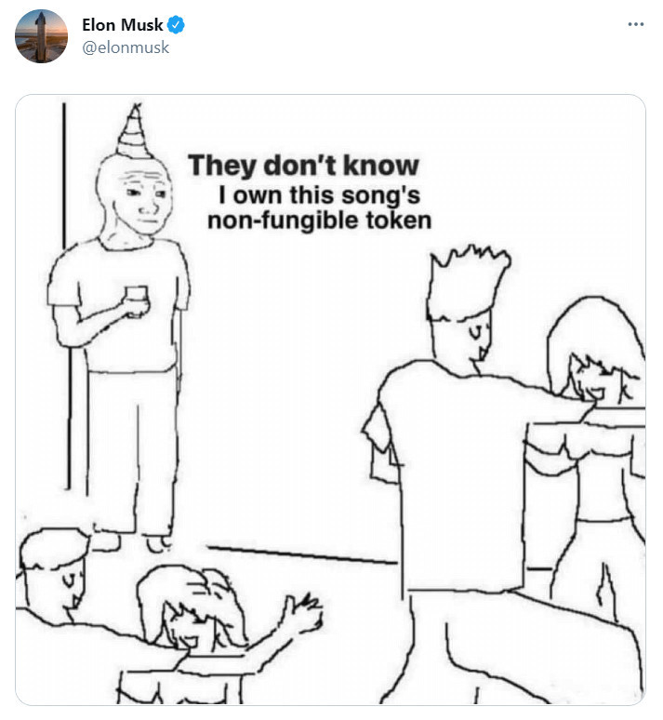
Non-Fungible Tokens (NFTs)
Every token is completely unique and not interchangeable
Act as proof of ownership of digital assets
Opens many doors for various industries
ERC - 721 standard

Slide 11
Questions?

Slide 12
Today’s Industry Highlight:
Token Trading

Slide 13
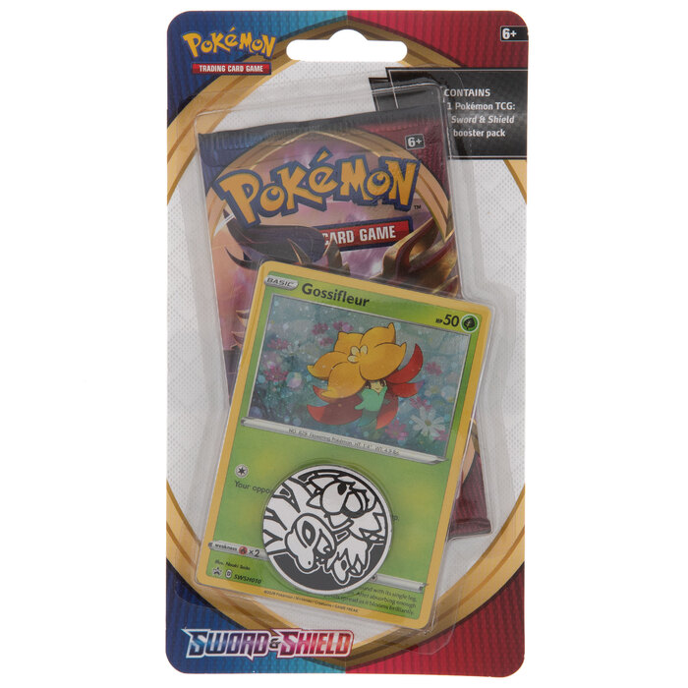
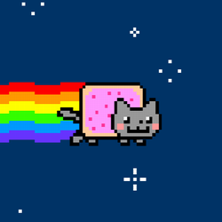
Digital Art
NFTs allow trade of ownership rights of digital assets
Art collecting through Blockchain
Have you ever played card trading games (Pokemon, etc.)? Now imagine every single card in the global collection being completely unique
Example: OpenSea
Beeple recently sold an NFT worth $69.3M

Slide 14
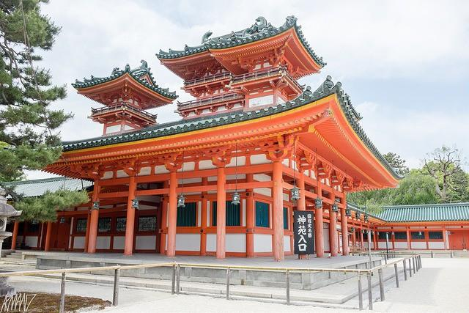
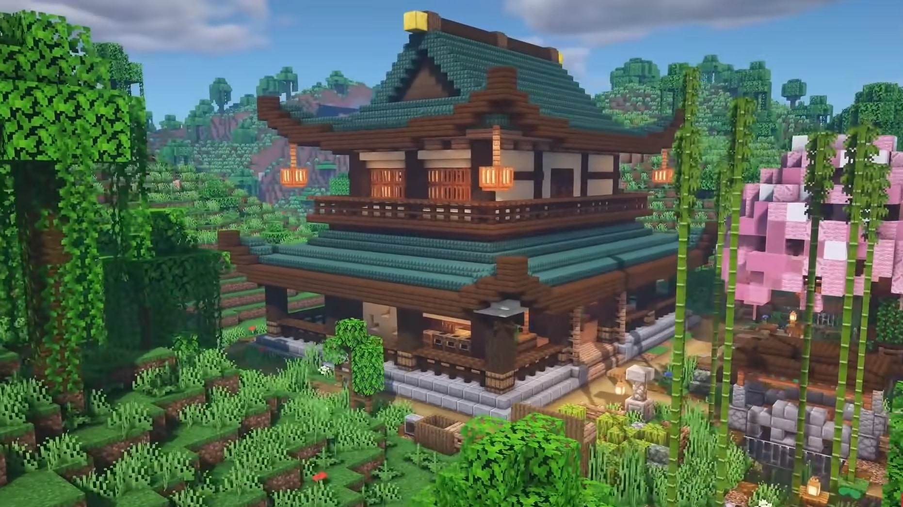
Estate: real and not-quite-real
NFTs allow for trading of digital real estate
However, innovation does not stop there, as there have been actual instances of non-digital real estate being sold as an NFT
This development is very new, and it’s hard to see any short-term benefits for the industry

Slide 15
Questions?

Slide 16

Review:
What is Layer 1?
What is Layer 2?

Slide 17
From last session, Let’s talk about layers...
DApps consist of two parts that we will refer to as layers:
Blockchain provides the crucial basis for a DApp that supplies it with all the crucial qualities we know to expect from blockchain tech (decentralized, secure, publicly available, etc.) - this foundation is referred to as Layer 1
Another network/technology operates on top of the blockchain layer (Layer 1) to offer additional benefits like time-efficiency, decreased costs, and scalability - this higher level network is known as Layer 2
To make use of these advantages, most or all of the transactional functionality is moved from Layer 1 to Layer 2
Layer 2 can consist of a different nested blockchain or state channels

Slide 18
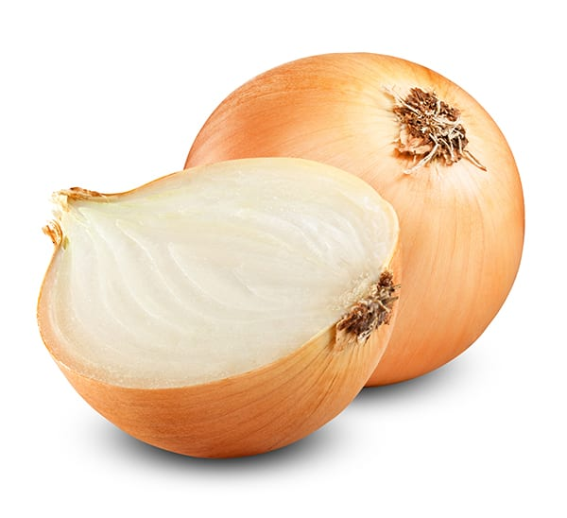
From last session, Layer 2: Advantages
Shortening time required to process transactions
Reducing the computational load allotted to nodes on the main chain
Decreasing costs associated with running the ledger
Allowing for greater scalability

Slide 19
Layer 2 beyond crypto transactions
So far transactions of crypto have been the only thing that we said can happen outside of Layer 1 in DApps
We saw an example of this with predictive market DApps that relied on oracles to trigger transactions
Is something else commonly transferred outside of Layer 1?
Yes, and the answer is tokens!

Slide 20
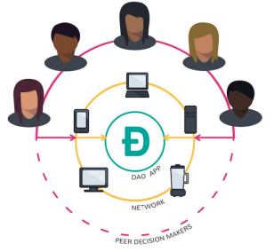
Governance DApps
Manage and decide on users’ ability to participate in governance
Usually written in combination with other DApps to provide a way to control them in a democratic decentralized manner
Smart contracts are used to define rules of governance and can be changed if the program enables changes
Widely used in DeFi
Hypothetically could be used on their own as a way of voting on policies unrelated to distributed ledgers, no real use cases as far as I know

Slide 21
Governance Tokens
Recall: tokens act as proof of ownership for a physical or digital asset
In this case the asset is the ability to propose policy and/or vote on proposals
Without governance tokens, distributed ledgers have to either be completely unable to change and adapt, or get rid of the advantages offered by their decentralized nature in favor of a centralized authority
A good example of a utility token

Slide 22
Questions?

Slide 23
Government:
the need for regulation?

Slide 24
Cryptocurrencies are currently banned in many countries (Egypt, China, Iraq, and others ...)
What are the advantages and disadvantages of banning crypto completely?

Slide 25
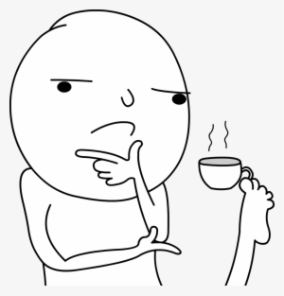
Group Activity:
Your Thoughts on Blockchain Regulation?
Think about the following questions:
What are the potential dangers of not regulating Blockchain technology?
Which aspects of Blockchain technology do you think need to be regulated and why?
Is it important to have multiple different regulating agencies? Why/Why not?
Which agencies do you think regulate (or should regulate) blockchain technology in the US?

Slide 26
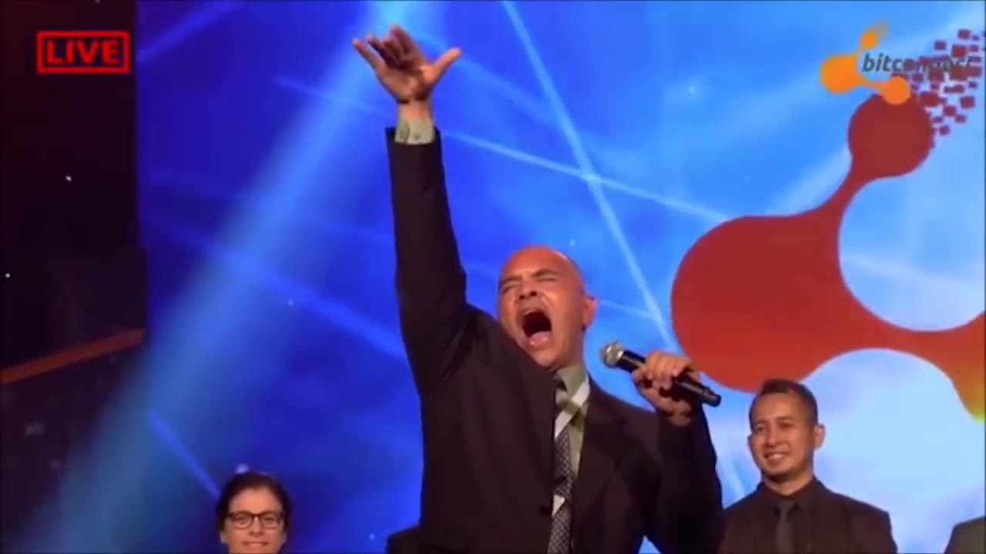
Let’s talk about Bitconnect...
Bitconnect Opening Ceremony
Article on the closure of the Bitconnect Ponzi scheme
A crypto lending platform, where initial investors were supposed to receive investment payments in return for backing it with Bitcoin
Run anonymously
Shut down in early 2018
Money = gone

Slide 27
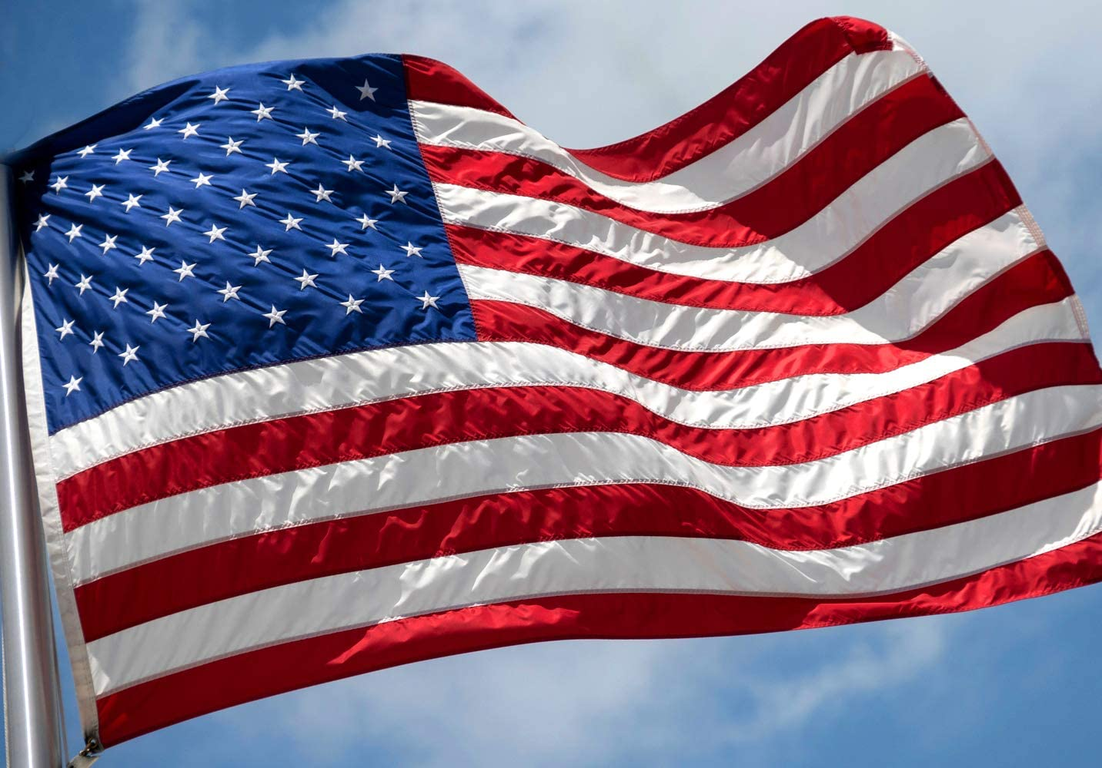
Blockchain Regulation in the US: Overview
US Regulatory Outlook: Views cryptocurrency as a positive, but requires agency level regulation (i.e. similar to pharmaceuticals, securities, etc.)
Regulating Agencies: Securities and Exchange Commission (SEC), Internal Revenue Service (IRS), Financial Crimes Enforcement Network (FinCEN)

Slide 28
US Cryptocurrency Regulatory Landscape
Unlike traditional assets, States are able to issue their own laws regarding cryptocurrency regulation
FinCen:
(Financial Crimes Enforcement Network, Department of treasury)
Not legal tender (i.e. not required to be accepted as payment)
Crypto exchanges are under their jurisdiction because money is being exchanged
IRS:
Considers cryptocurrency “property” (i.e. just like a stock)
Subject to standard long term capital gains treatment
SEC:
Traditional cryptocurrencies are not securities because they are “replacements for sovereign currencies, replace the dollar, the euro, the yen with bitcoin. That type of currency is not a security” (SEC Chairman Jay Clayton)
“A token, or digital asset used in fundraising process known as an initial coin offering, or ICO, are securities” (CNBC)
Crypto - not a security, Token - security

Slide 29
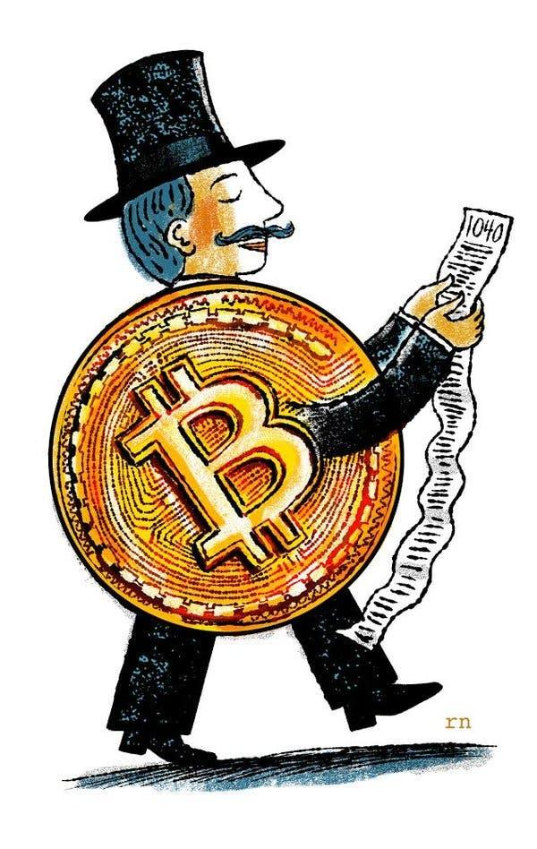
Taxing Crypto
Cryptocurrency is legal in the US and is used to store monetary value
Therefore it needs to be taxed
The IRS handles taxation of crypto
Crypto traders must pay capital gains taxes on the profits they earn
Present tax rate: 10-37% for short-term capital gains, 0-20% for long-term capital gains (held for more or less than 365 days)
Specific percentage determined by income level
Read More
NYT article from 2018 on taxing Bitcoin

Slide 30
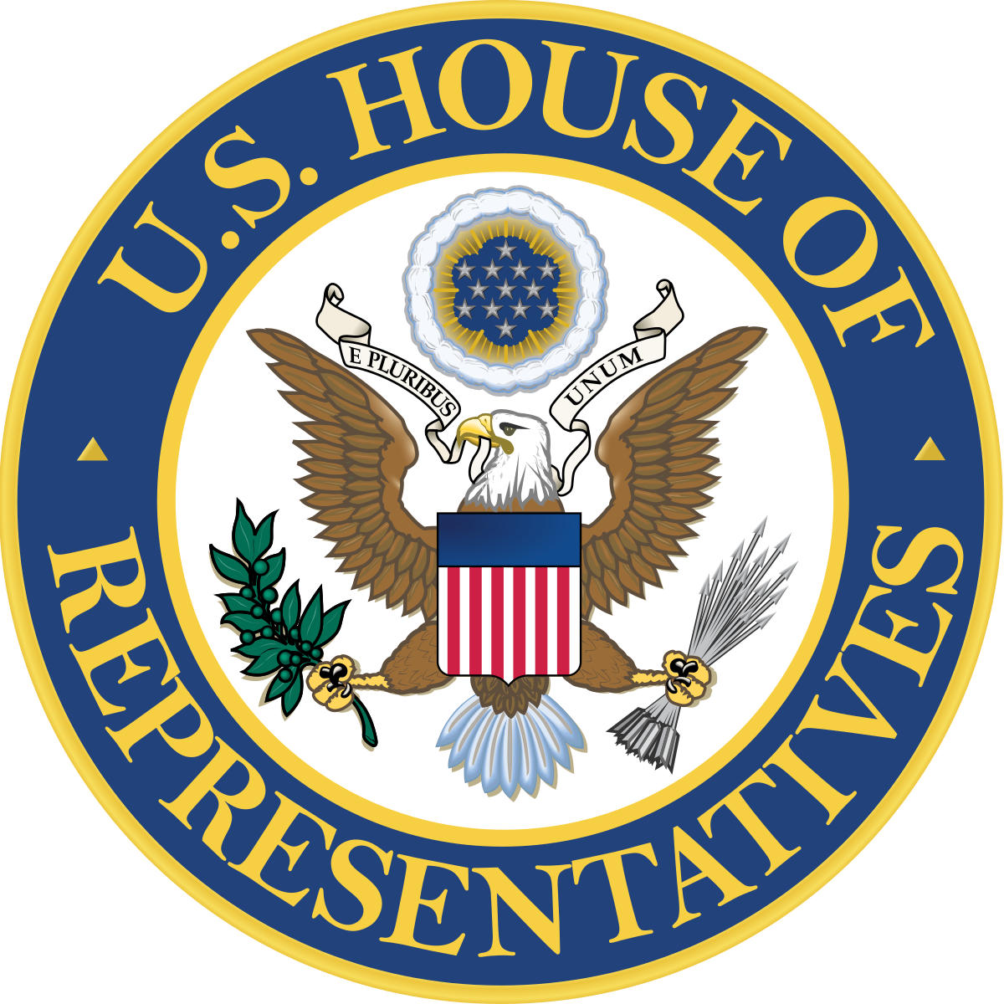
Uncertainty on the Federal Level
There are currently many bills around blockchain regulation in both the House of Representatives and the Senate
States take radically different stances towards blockchain
TLDR: it’s complicated

Slide 31
Remember to register for 1:1s!
If you have no idea what I am talking about, check Colin’s message in the cohort slack channel

Slide 32
Thank You :)

